Slide 1
Computations done on table data
Arithmetic Operators
+ Addition * Multiplication
- Subtraction ** Exponentiation
/ Division ( ) Enclosed operation

Slide 2
Emp_no | E_Name | Dept | Designation | Salary _per _hr | Total_ hrs _worked
1200 | Anand | Production | Superviser | 400 | 50
1201 | Beena | Account | Clerk | 350 | 60
1202 | Tom | Sales | Executive | 500 | 55
1203 | Rita | Account | Manager | 600 | 50
1204 | Rahul | Sales | Clerk | 350 | 62
1205 | Mahesh | Service | Technician | 450 | 61

Slide 3
Example:
Calculate the salary to be paid for each employee and display the same.
Query:
SELECT Emp_no, E_Name,Dept,Designation,Salary_per_hr,Total_hrs_worked, Salary_per_hr*Total_hrs_worked FROM Employee;

Slide 4
Emp_no | E_Name | Dept | Designation | Salary _per _hr | Total_ hrs _worked | Salary_per_hr*Total_hrs_worked
1200 | Anand | Production | Superviser | 400 | 50 | 20000
1201 | Beena | Account | Clerk | 350 | 60 | 21000
1202 | Tom | Sales | Executive | 500 | 55 | 27000
1203 | Rita | Account | Manager | 600 | 50 | 30000
1204 | Rahul | Sales | Clerk | 350 | 62 | 21700
1205 | Mahesh | Service | Technician | 450 | 61 | 27450

Slide 5
Renaming output columns with an alias
Syntax:
SELECT columnname aliasname,columnname aliasname FROM tablename
Example:
SELECT Emp_no , E_Name,Dept,Designation,Salary_per_hr,Total_hrs_worked, Salary_per_hr*Total_hrs_worked “Salary to be paid” FROM Employee;

Slide 6
Emp_no | E_Name | Dept | Designation | Salary _per _hr | Total_ hrs _worked | Salary to be paid
1200 | Anand | Production | Superviser | 400 | 50 | 20000
1201 | Beena | Account | Clerk | 350 | 60 | 21000
1202 | Tom | Sales | Executive | 500 | 55 | 27000
1203 | Rita | Account | Manager | 600 | 50 | 30000
1204 | Rahul | Sales | Clerk | 350 | 62 | 21700
1205 | Mahesh | Service | Technician | 450 | 61 | 27450

Slide 7
2. Logical Operators:
The AND operator:
The rows in the table for which all of the conditions specified using the AND operator are displayed.
Ex:
SELECT Emp_no,E_Name,Dept,Total_hrs_worked FROM Employee WHERE Total_hrs_worked >55 AND Total_hrs_worked < 65;

Slide 8
Emp_no | E_Name | Dept | Total_ hrs _worked
1201 | Beena | Account | 60
1204 | Rahul | Sales | 62
1205 | Mahesh | Service | 61

Slide 9
ii. The OR Operator:
The rows in the table for which any one of the conditions specified using the OR operator are displayed.
Example:
SELECT * FROM Employee WHERE Dept=‘Accounts’ OR Designation=‘Clerk’;

Slide 10
Emp_no | E_Name | Dept | Designation | Salary _per _hr | Total_ hrs _worked
1201 | Beena | Account | Clerk | 350 | 60
1203 | Rita | Account | Manager | 600 | 50
1204 | Rahul | Sales | Clerk | 350 | 62

Slide 11
The NOT operator:
The rows in the table for which specified condition is not satisfied are displayed.
Example:
SELECT * FROM Employee WHERE NOT Dept=‘Account’;

Slide 12
Emp_no | E_Name | Dept | Designation | Salary _per _hr | Total_ hrs _worked
1200 | Anand | Production | Superviser | 400 | 50
1202 | Tom | Sales | Executive | 500 | 55
1204 | Rahul | Sales | Clerk | 350 | 62
1205 | Mahesh | Service | Technician | 450 | 61

Slide 13
3. Range Searching:
In order to select data within a range of values , the BETWEEN operator is used.
Syntax:
SELECT columnname,columnname FROM tablename WHERE expression BETWEEN lowerlimit expression AND upperlimit expression;
EXAMPLE:
SELECT * FROM Employee WHERE Total_hrs_worked BETWEEN 55 AND 65;

Slide 14
Emp_no | E_Name | Dept | Total_ hrs _worked
1201 | Beena | Account | 60
1204 | Rahul | Sales | 62
1205 | Mahesh | Service | 61

Slide 15
4. Pattern Matching:
The LIKE operator is used to perform pattern matching. i.e. to compare one string value with another string value.
For character data types:
% allows to match any string of any length.
_ allows to match on a single character.

Slide 16
Example:
List the Employees whose name begins with letter “R”
SELECT * FROM Employee WHERE E_Name LIKE ’R%’;

Slide 17
Emp_no | E_Name | Dept | Designation | Salary _per _hr | Total_ hrs _worked
1203 | Rita | Account | Manager | 600 | 50
1204 | Rahul | Sales | Clerk | 350 | 62

Slide 18
Example:
List the employees whose name has ‘a’ as the second character.
Query:
SELECT * FROM Employee WHERE E_Name LIKE ‘_a%’;

Slide 19
Emp_no | E_Name | Dept | Designation | Salary _per _hr | Total_ hrs _worked
1204 | Rahul | Sales | Clerk | 350 | 62
1205 | Mahesh | Service | Technician | 450 | 61

Slide 20
The IN and NOT IN operators:
IN operator is used in situations where a value needs to be compared with list of values.
Example:
List the employees who are in production,sales and service departments
Query:
SELECT * FROM Employee WHERE Dept IN (‘Production’ , ’Sales’ , ’service’);

Slide 21
Emp_no | E_Name | Dept | Designation | Salary _per _hr | Total_ hrs _worked
1200 | Anand | Production | Superviser | 400 | 50
1202 | Tom | Sales | Executive | 500 | 55
1204 | Rahul | Sales | Clerk | 350 | 62
1205 | Mahesh | Service | Technician | 450 | 61

Slide 22
Example:
List the employees who are not in Sales,Service department.
Query:
SELECT * FROM Employee WHERE Dept NOT IN(‘Sales’ , ‘Service’);

Slide 23
Emp_no | E_Name | Dept | Designation | Salary _per _hr | Total_ hrs _worked
1200 | Anand | Production | Superviser | 400 | 50
1201 | Beena | Account | Clerk | 350 | 60
1203 | Rita | Account | Manager | 600 | 50

Slide 24
The Oracle table - DUAL
DUAL is a Oracle worktable, which contains only one row and one column and contains value x in that column.
It supports arithmetic calculations and date retrieval and formatting.
When there is arithmetic calculation and there is no table being referenced then Oracle provides a dummy table called DUAL , against which SELECT statement can be given.

Slide 25
The structure of DUAL:
DESC DUAL;
Output:
Name | Null? | Type
Dummy |  | VARCHAR2(1)

Slide 26
Query for records:
SELECT * FROM DUAL;
Output:
D
X

Slide 27
Example:
Query:
SELECT 2*2 FROM DUAL;
Output:
2*2
4

Slide 28
SYSDATE
SYSDATE is a pseudo column that contains current date and time.
Example:
SELECT SYSDATE FROM DUAL;
Output:
SYSDATE
25-DEC-2017

Slide 29
Oracle Functions
Oracle functions are used for the purpose of manipulating data and returning a result.
Functions are also capable of handling user-supplied data and operating on them.
General form is
FunctionName(argument1,argument2,….)

Slide 30
Classifications of Oracle Functions
Group Functions(Aggregate Functions)
- Functions that act on a set of values. Ex: SUM
Scalar Functions(Single Row Functions)
Functions that act only on one value. Ex:LENGTH
Scalar Functions are further divided into:
String Functions
Numeric Functions
Conversion Functions
Date Functions

Slide 31
Aggregate Functions
AVG
Syntax:
AVG([DISTINCT|ALL]n)
Purpose:
Returns average of n ignoring the null value
Example:
SELECT AVG(Total_hrs_worked) “Average Working Hour” FROM Employee;
Output:
Average Working Hour
56

Slide 32
2) MIN
Syntax:
MIN([DISTINCT|ALL]expr)
Purpose:
Returns minimum value of expression
Example:
SELECT MIN(Total_Hrs_Worked) “Minimum” FROM Employee;

Slide 33
Output
Minimum
50

Slide 34
3) MAX
Syntax:
MAX([DISTINCT|ALL]expr)
Purpose:
Returns maximum value of expression
Example:
SELECT MAX(Total_Hrs_Worked) “Maximum” FROM Employee;

Slide 35
Output
Maximum
62

Slide 36
4) COUNT(*)
Syntax:
COUNT(*)
Purpose:
Returns the number of rows in the table,including the duplicates and with nulls.
Example:
SELECT COUNT(*) “Total” FROM Employee;

Slide 37
Output
Total
6

Slide 38
5) COUNT(expr)
Syntax:
COUNT([DISTINCT|ALL]expr)
Purpose:
Returns the number of rows where expr is not null
Example:
SELECT COUNT(Dept) “Count” FROM Employee;

Slide 39
Output
Count
4

Slide 40
6) SUM
Syntax:
SUM([DISTINCT|ALL]n)
Purpose:
Returns sum of values of n
Example:
SELECT SUM(Total_Hrs_Worked) “Total” FROM Employee;

Slide 41
Output
Total
338

Slide 42
Numeric Functions
1) ABS
Syntax:
ABS(n)
Purpose:
Returns the absolute value of n
Example:
SELECT ABS(-15) “Absolute” FROM DUAL;

Slide 43
Output
Absolute
15

Slide 44
2. POWER
Syntax:
POWER(m,n)
Purpose:
Returns m raised to the nth power(m^{n} ). n must be an integer.
Example:
SELECT POWER(4,2) “Power” FROM DUAL;

Slide 45
Output
Power
16

Slide 46
3) ROUND
Syntax:
ROUND(n[,m])
Purpose:
Returns n, rounded to m places to the right of the decimal point. If m is not given n is rounded to 0 places.
Example:
SELECT ROUND(15.19,1) “Round” FROM DUAL;

Slide 47
Output
Round
15.2

Slide 48
4) SQRT
Syntax:
SQRT(n)
Purpose:
Returns the square root of n
Example:
SELECT SQRT(25) “Square root” FROM DUAL;
Output:

Slide 49
Output
Square Root
5

Slide 50
5) EXP
Syntax:
EXP(n)
Purpose:
Returns the exponent value of n. i.e., e^{n}
Where e=2.71828183
Example:
SELECT EXP(5) “Exponent” FROM DUAL;

Slide 51
Output
Exponent
148.413159

Slide 52
6) EXTRACT
Syntax:
EXTRACT({year|month|day|hour|minute|timezone_hour|timezone_minute|timezone_region|timezone_abbr} FROM {date_value|interval_value})
Purpose:
Returns a value extracted from a date or interval value.
Example:
SELECT EXTRACT(YEAR FROM DATE ‘2018-01-01’) “Year” FROM DUAL;
Output:

Slide 53
Output
Year
2018

Slide 54
7) GREATEST
Syntax:
GREATEST(expr1,expr2,….exprn)
Purpose:
Returns the greatest value in a list of n expressions.
Example:
SELECT GREATEST(4,8,19) “Greatest” FROM DUAL;
Output:

Slide 55
Output
Greatest
19

Slide 56
8) LEAST
Syntax:
LEAST(expr1,expr2,….exprn)
Purpose:
Returns the least value in a list of n expressions.
Example:
SELECT LEAST(4,8,19) “Least” FROM DUAL;

Slide 57
Output
Least
4

Slide 58
9) MOD
Syntax:
MOD(m,n)
Purpose:
Returns the remainder of a first number divided by the second number.
Example:
SELECT MOD(17,7) “Remainder” FROM DUAL;

Slide 59
Output
Remainder
3

Slide 60
10) TRUNC
Syntax:
TRUNC(number,[decimal places])
Purpose:
Returns a number truncated to a certain number of decimal places.
Example:
SELECT TRUNC(136.81,1) “Truncated” FROM DUAL;

Slide 61
Output
Truncated
136.8

Slide 62
11) FLOOR
Syntax:
FLOOR(n)
Purpose:
Returns the largest integer value that is equal to or less than a number.
Example:
SELECT FLOOR(23.8) “Floor1” ,FLOOR(12.16) “Floor2” FROM DUAL;

Slide 63
Output
Floor1 | Floor2
23 | 12

Slide 64
12) CEIL
Syntax:
CEIL(n)
Purpose:
Returns the smallest integer value that is equal to or greater than a number.
Example:
SELECT CEIL(23.8) “Ceil1” ,CEIL(12.16) “Ceil2” FROM DUAL;

Slide 65
Output
Ceil1 | Ceil2
24 | 13

Slide 66
String Functions
1) LOWER
Syntax:
LOWER(char)
Purpose:
Returns char,with all letters in lowercase
Example:
SELECT LOWER(‘IVAN BAYROSS’) “Lower” FROM DUAL;

Slide 67
Output
Lower
ivan bayross

Slide 68
2) INITCAP
Syntax:
INITCAP(char)
Purpose:
Returns a string with the first letter of each word in uppercase
Example:
SELECT INITCAP(‘IVAN BAYROSS’) “Title Case” FROM DUAL;

Slide 69
Output
Title Case
Ivan Bayross

Slide 70
3) UPPER
Syntax:
UPPER(char)
Purpose:
Returns char,with all letters in uppercase
Example:
SELECT UPPER(‘bca’) “Upper” FROM DUAL;

Slide 71
Output
Upper
BCA

Slide 72
4) SUBSTR
Syntax:
SUBSTR(string,start position,[length]) where string is the source string, start position is the position for extraction, length is the number of characters to extract.
Purpose:
Returns a portion of characters from start position to the given length of characters. If length is not given then substring will be extracted till the last character.
Example:
SELECT SUBSTR(‘ibca students’,2,3) “Substring1”, SUBSTR( ‘ibca students’,6) FROM DUAL;

Slide 73
Output
Substr1 | Substr2
bca | students

Slide 74
5) ASCII
Syntax:
ASCII(single character)
Purpose:
Returns the NUMBER code that represents the specified character.
Example:
SELECT ASCII(‘a’) “ASCII” FROM DUAL;

Slide 75
Output
ASCII
97

Slide 76
6) INSTR
Syntax:
INSTR(string1,string2,[start position],[nth appearance])
String1 – string to search
String2 – is the substring to search for in string1
Purpose:
Returns the location of a substring in a string
Example:
SELECT INSTR(‘SCT on the net’ , ‘t’) “Instr1”,INSTR(‘SCT on the net’, ‘t’,1,2) “Instr2” FROM DUAL;

Slide 77
Output
Instr1 | Instr2
8 | 14

Slide 78
7) TRANSLATE
Syntax:
TRANSLATE(string1,string_to_replace,replacement string)
String1 – string to replace a sequence of characters with another set of characters.
String_to_replace – is the string that will be searched for in string1
Purpose:
Replaces a sequence of characters in a string with another set of characters. It replaces a single character at a time.
Example:
SELECT TRANSLATE(‘1sct523’, ‘123’ , ‘7a9’) “Change” FROM DUAL;

Slide 79
Output
Change
7sct5a9

Slide 80
8) LENGTH:
Syntax:
LENGTH(word)
Purpose:
Returns the length of a word.
Example:
SELECT LENGTH(‘GFGC’) “Length” FROM DUAL;

Slide 81
Output
Length
4

Slide 82
9) LTRIM:
Syntax:
LTRIM(char[,set])
Purpose:
Removes characters from the left of char.
set – specifies the characters to be removed.
If set is not given then if there is any space in the left of the character will be removed.
Example:
SELECT LTRIM(‘GFGC’,’G’) “Ltrim1”,LTRIM(‘ GFGC’) “Ltrim2”, LTRIM(‘GFGC’,’GFKI’) “Ltrim3” FROM DUAL;

Slide 83
Output
Ltrim1 | Ltrim2 | Ltrim3
FGC | GFGC | GC

Slide 84
10) RTRIM:
Syntax:
RTRIM(char[,set])
Purpose:
Removes characters from the right of char.
set – specifies the characters to be removed.
If set is not given then if there is any space in the right of the character will be removed.
Example:
SELECT RTRIM(‘IBCA students’,’students’) “Rtrim” FROM DUAL;

Slide 85
Output
Rtrim
IBCA

Slide 86
11) TRIM:
Syntax:
TRIM([leading | trailing | both [trim_string FROM]] string1)
Purpose:
Removes specified characters either from the beginning or the ending of a string.
Leading – remove trim_string from the front of string1
Trailing - remove trim_string from the end of string1
Both remove trim_string from front and end of string1

Slide 87
Example 1:
SELECT TRIM(‘students IBCA students’,’students’) “trim both sides” FROM DUAL;
Output:
Trim both sides
IBCA

Slide 88
Example 2:
SELECT TRIM(LEADING ‘students IBCA students’,’students’) “Trim leading” FROM DUAL;
Output:
Trim leading
IBCA students

Slide 89
Example 3:
SELECT TRIM(TRAILING‘students IBCA students’,’students’) “Trim trailing” FROM DUAL;
Output:
Trim trailing
students IBCA

Slide 90
12) LPAD:
Syntax:
LPAD(char1,n[,char2])
Purpose:
Returns char1, left-padded to length n with the sequence of characters specified in char2. If char2 is not given blank spaces will be padded.
Example:
SELECT LPAD(‘Page 1’,10,’*’) “Lpad” FROM DUAL;

Slide 91
Output
Lpad
****Page 1

Slide 92
12) RPAD:
Syntax:
RPAD(char1,n[,char2])
Purpose:
Returns char1, right-padded to length n with the sequence of characters specified in char2. If char2 is not given blank spsces will be padded.
Example:
SELECT RPAD(‘Page 1’,10,’*’) “Rpad” FROM DUAL;

Slide 93
Output
Rpad
Page 1****

Slide 94
13) VSIZE:
Syntax:
VSIZE(expression)
Purpose:
Returns the number of bytes in the internal representation of an expression.
Example:
SELECT VSIZE(‘SCT on the net’) “Size” FROM DUAL;

Slide 95
Output
Size
14

Slide 96
Conversion Functions
1) TO_NUMBER:
Syntax:
TO_NUMBER(char)
Purpose:
Converts char, a CHARACTER value expressing a number , to a NUMBER data type.
Example:
SELECT TO_NUMBER(‘26’) “Number” FROM DUAL;

Slide 97
Output
Number
26

Slide 98
Conversion Functions
2) TO_CHAR(number conversion):
Syntax:
TO_CHAR(n[,format])
Purpose:
Converts a value of NUMBER datatype to a character datatype using the optional format string.
Example:
SELECT TO_CHAR(‘17145’,’$099,999’) “Char” FROM DUAL;

Slide 99
Output
Char
$017,145

Slide 100
3) TO_CHAR(date conversion):
Syntax:
TO_CHAR(date[,format])
Purpose:
Converts a value of DATE datatype to a character datatype using the optional format string.
Example:
SELECT TO_CHAR(’06-01-2018’,’Month DD YYYY’) “New date format” FROM DUAL;

Slide 101
Output
New date format
January , 16, 2018

Slide 102
4) TO_DATE:
Syntax:
TO_DATE(char value[,format])
Purpose:
Converts a value of CHARACTER data type to a DATE data type using the optional format string.
Example:
SELECT TO_DATE(’06/01/2018’,’DD/MM/YY’) “New date format” FROM DUAL;

Slide 103
Output
New date format
06-JAN-2018

Slide 104
DATE FUNCTIONS
1)ADD_MONTHS:
Syntax:
ADD_MONTHS(d,n)
Purpose:
Returns date after adding the number of months specified in the function.
Example:
SELECT ADD_MONTHS(SYSDATE,4) “Add months” FROM DUAL;

Slide 105
Output
Add months
06-May-2018

Slide 106
2)LAST_DAY:
Syntax:
LAST_DAY(d)
Purpose:
Returns the last date of the month specified with the function.
Example:
SELECT SYSDATE,LAST_DAY(SYSDATE) “Last day” FROM DUAL;

Slide 107
Output
SYSDATE | Last day
16-JAN-2018 | 31-JAN-2018

Slide 108
3)MONTHS_BETWEEN:
Syntax:
MONTHS_BETWEEN(d1,d2)
Purpose:
Returns the number of months between d1 and d2.
Example:
SELECT MONTHS_BETWEEN(‘02-FEB-2018’,’02-JAN-2018’) “Months ” FROM DUAL;

Slide 109
Output
Months
1

Slide 110
4)NEXT_DAY:
Syntax:
NEXT_DAY(date,char)
Purpose:
Returns the date of the first weekday named by char that is after the date named by date.
Example:
SELECT NEXT_DAY(‘16-JAN-2018’,’Saturday’) “Next day” FROM DUAL;

Slide 111
Output
Next day
20-JAN-2018

Slide 112
Special date formats using TO_CHAR function
DDTH places TH,RD,ND for the date(DD). E.g.,2ND, 3RD, 08th etc.
DDSP indicates that the date(DD) must be displayed by spelling the date such as ONE,TWELVE etc.
DDSPTH displace the date (DD) with TH added to the spelling. E.g., Twenty-fifth, fourteenth etc.

Slide 113
Miscellaneous Functions
1) UID:
Syntax:
UID [INTO variable]
Purpose:
The function returns an integer value corresponding to the UserID of the user currently logged in. If the optional variable is given the user id will be stored in that variable.
Example:
SELECT UID FROM DUAL;

Slide 114
Output
UID
12

Slide 115
2) USER:
Syntax:
USER
Purpose:
The function returns the user name of the user currently logged in.
Example:
SELECT USER FROM DUAL;

Slide 116
Output
USER
SYSTEM

Slide 117
3) SYS_CONTEXT:
Syntax:
SYS_CONTEXT(namespace, parameter [, length])
Purpose:
Can be used to retrieve information about Oracle’s environment.
Namespace – is an oracle namespace that has already been created. E.g.,USERENV
Parameter – if USERENV is the namespace the parameters can be CLIENT_INFO, CURRENT_USER,CURRENT_USERID etc.
Length – is the length of the return value in bytes.
Example:
SELECT SYS_CONTEXT(‘USERENV’, NLS_DATE_FORMAT’) “Syscontext” FROM DUAL;

Slide 118
Output
Syscontext
DD_MON_RR

Slide 119
4) USERENV:
Syntax:
USERENV(parameter)
Purpose:
Can be used to retrieve information about the current Oracle session.
Namespace – is an oracle namespace that has already been created. E.g.,USERENV
Parameter – is the value to return from the current oracle session.
Example:
SELECT USERENV(’LANGUAGE’) FROM DUAL;

Slide 120
Output
USERENV(‘LANGUAGE’)
AMERICAN_AMERICA.WE8MSWIN1252

Slide 121
Grouping data from tables in SQL
GROUP BY and HAVING clauses fecilitate selective retrieval of rows.
These are parallel to ORDER BY and WHERE clause except that they act on record sets, and not on individual records.

Slide 122
GROUP BY clause
Syntax:
SELECT columnname1,columnname2,columnnameN, Aggregate_Function(expression)
FROM tablename
GROUP BY columnname1,columnname2,columnnameN;
Example:
Find out how many employees are there in each dept.
Query:
SELECT dept “Department”, COUNT(Emp_no) “No of employees” FROM employee GROUP BY dept;

Slide 123
Output
Department | No of employees
Account | 2
Production | 1
Sales | 2
Service | 1

Slide 124
HAVING clause
HAVING clause is used in conjunction with the GROUP BY clause to impose some condition on GROUP BY clause.
Syntax:
SELECT columnname1,columnname2,columnnameN, Aggregate_Function(expression)
FROM tablename
GROUP BY columnname1,columnname2,columnnameN HAVING condition;
Example:
Find out how many employees are there in each dept whose total _hours_worked is > 50
Query:
SELECT dept “Department”, COUNT(Emp_no) “No of employees” FROM employee GROUP BY dept HAVING total_hrs_worked>50;

Slide 125
Output
Department | No of employees
Account | 1
Production | 1
Sales | 2
Service | 1

Slide 126
Subqueries
A subquery is a form of SQL statement that appears inside another SQL statement.
The parent statement uses the rows returned by the subquery.
Subqueries can be used
To insert records in a target table
To create tables and insert records in the table created
To update records in a target table
To create views
To provide values for conditions in WHERE,HAVING,IN clauses.

Slide 127
Inline view:
The concept of using a subquery in the FROM clause of the SELECT statement is called inline view.
Correlated subquery:
A correlated subquery is one where a subquery references a column from a table in the parent query.
A correlated subquery is evaluated once for each row of the parent statement, which can be any of the SELECT, UPDATE or DELETE
The EXISTS enables to test whether a value retrieved by the outer query exists in the result set of the values retrieved by the inner query. If the subquery returns at least one row, the operator returns true. If the value does not exist, it returns false.
The EXISTS operator ensures that the search in the inner query terminates when at least one match is found.
The NOT EXISTS operator enables to test whether a value retrieved by the outer query is not a part of the result set of the values retrieved by the inner query.

Slide 128
Employee table
ENO | Name | Salary | DEPT NO
101 | Harshal | 6000 | D002
102 | Mandar | 7000 | D001
103 | Vaishnavi | 5000 | D003
104 | Adarsh | 8000 | D001
105 | Ranjan | 4000 | D004
106 | Megha | 5500 | D003

Slide 129
Dept table
Dept no | Dept name | Location
D001 | Accounts | Chennai
D002 | Research | Mumbai
D003 | HRD | Bangalore
D004 | EDP | Hyderabad
D005 | Inventory | Goa

Slide 130
Example 1
Display the names of employees who are working in Chennai
Query:
SELECT ename FROM employee WHERE deptno in (select dno from depart where loc=‘Chennai’);
Notes:
Second query output: D0001

Slide 131
Output
Ename | Location
Mandar | Chennai
Adarsh | Chennai

Slide 132
Example 2:
Display the location where Vaishnavi is working
Query:
select loc from depart where dno=(select deptno from employee where ename=‘Vaishnavi');
Notes:
Second query output:D0003

Slide 133
Output
Loc
Bangalore

Slide 134
Example 3:
List the employee number, employee name, salary and average salary of the department whose salary is more than the average salary in the department(inline view)
QUERY:
select a.empno,a.ename,a.sal,b.avgsal from employee a,(select deptno,avg(sal) avgsal from employee group by deptno) b where a.deptno=b.deptno and a.sal>b.avgsal
Notes:
Second query output:D0001 7500,D0002 6000, D0003 5250, D0004 4000

Slide 135
Output
empno | ename | sal | avgsal
104 | Adarsh | 8000 | 7500
106 | Megha | 5500 | 5250

Slide 136
Example 4:
List the employee names, salary who are drawing maximum salary in each department (correlated subquery)
Query:
select ename,deptno,sal from employee where sal = (select max(sal) from employee where deptno=employee.deptno);

Slide 137
Output
Ename | deptno | sal
Adarsh | D001 | 8000
Harshal | D002 | 6000
Megha | D003 | 5500
Ranjan | D004 | 4000

Slide 138
Example 5:
List the departments that do not have any employees
Query:
select dno,dname from depart a where not exists(select deptno from employee where deptno=a.dno);

Slide 139
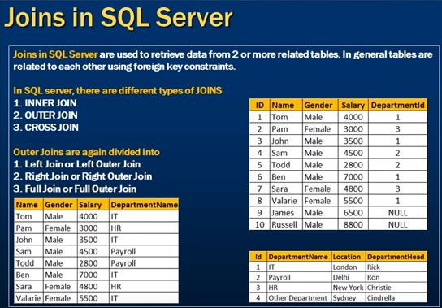

Slide 140
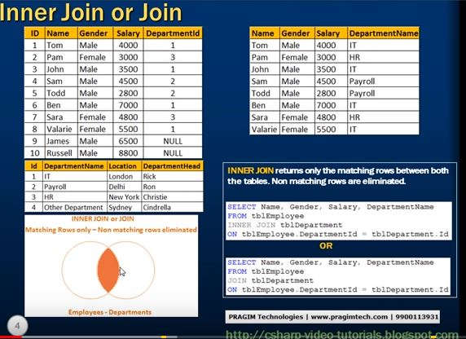

Slide 141
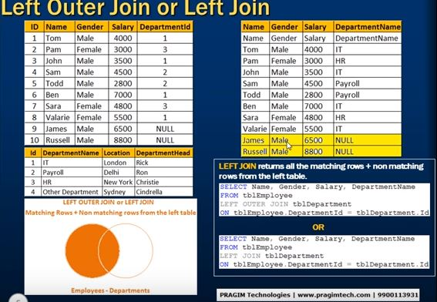

Slide 142
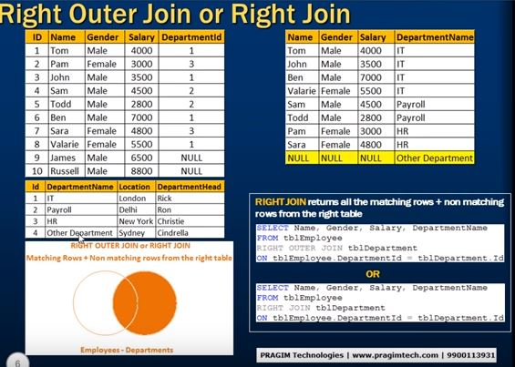

Slide 143
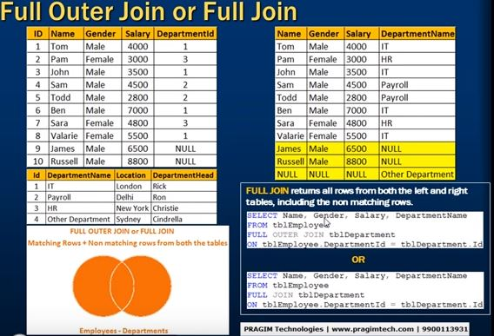

Slide 144
